Slide 1
LOCKR
A Open-Source and Private Password Manager
Team Members: Lucas Beeman, Pat Kelly, Ja’Quez Oracio, and Aiden Terziu
Notes:
Good morning everyone, My name is Pat Kelly and I will be presenting for my group and our product: LOCKR (like locker).
Before we begin, I just want to say that this was a awesome experience, my team and myself had a great time not only learning but working towards a common goal and learning new skills.

Slide 2
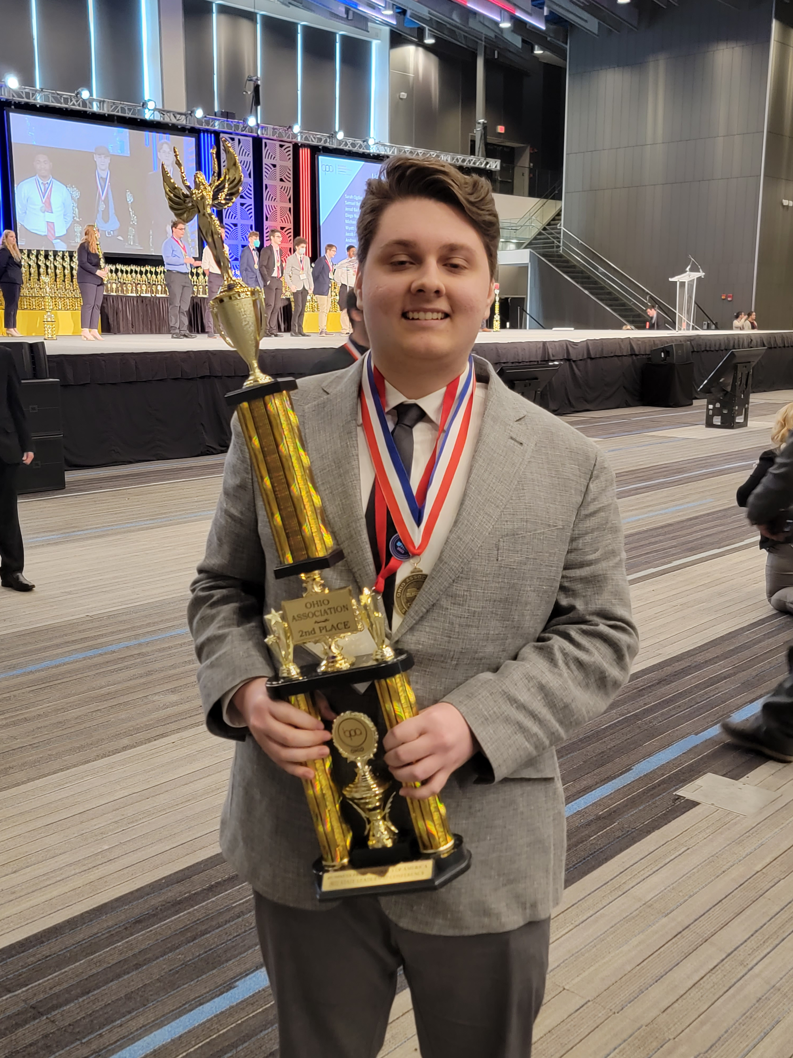
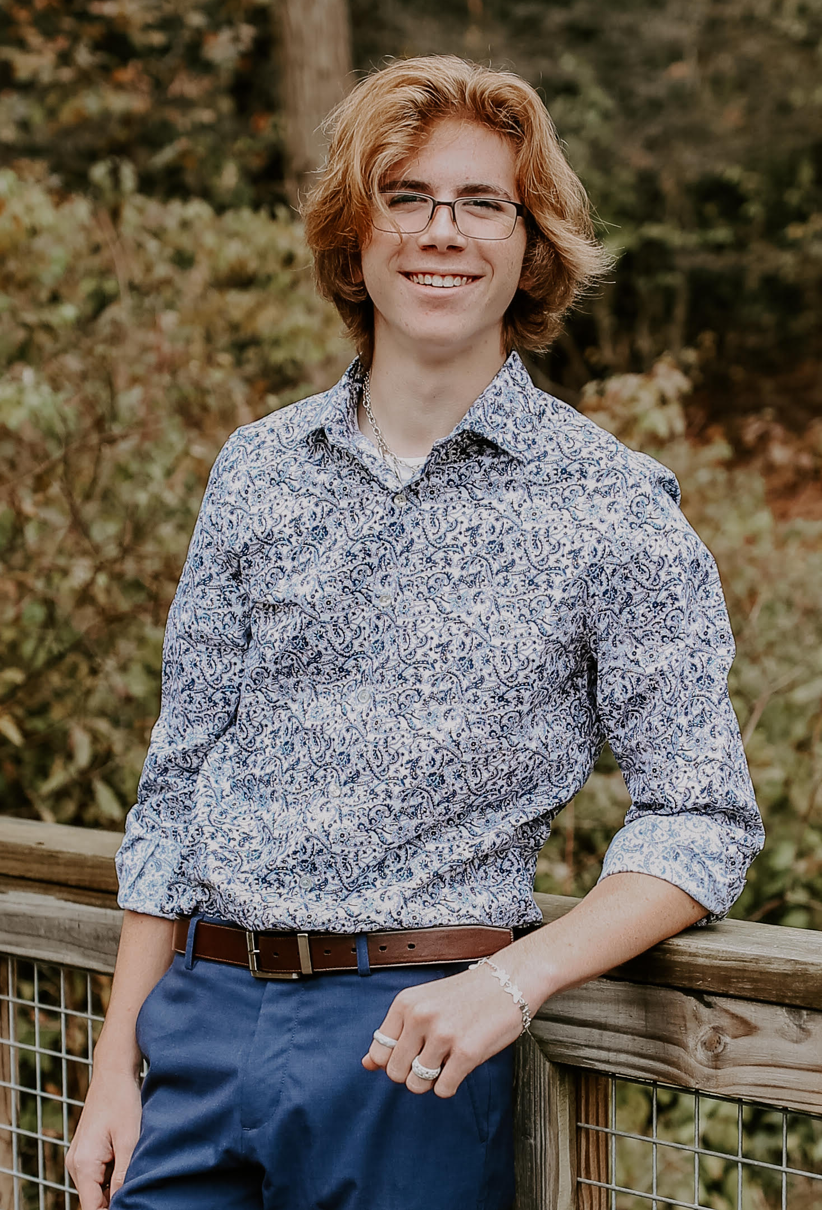
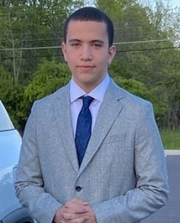
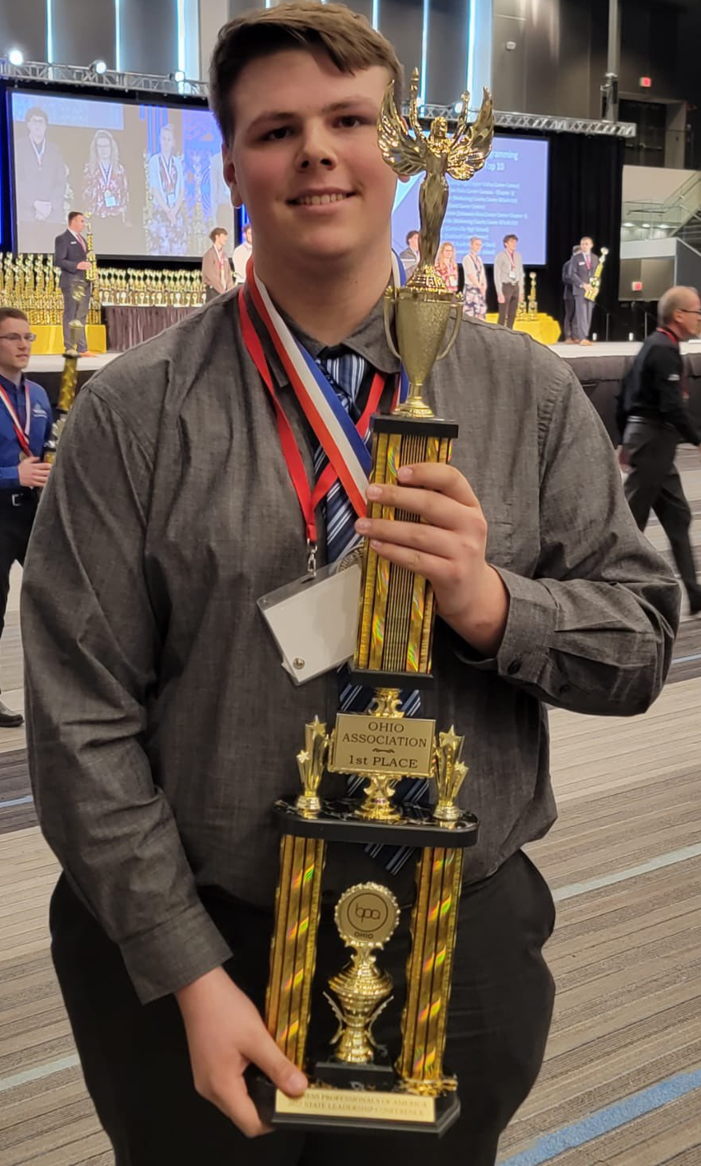
Meet the LOCKR Team
Lucas: A Senior at MCCTC in Software Engineering, with skills in HTML5, front end development, Python, JavaScript, Visual Studio Suite HTML5, C#, C++, Unreal Engine, .NET applications, Unity, and placed 2nd in C++ Programming in BPA State Competition. He is going to Akron University for computer science
Pat: A Senior in the Cybersecurity and Networking class, who is proficient in Windows server administration, Pentesting tools, Python, Kali Linux, Visual Studio Code, HTML, CSS, and placed 2nd in Computer Networking Tech. at BPA Regional Competition. He is going to University of Akron in the fall for Information Systems.
Ja’Quez: A Software Engineering Senior at MCCTC who specializes in React.js, Python, JavaScript, Visual Studio Suite HTML5, C#, C++, Unreal Engine, and Unity. He plans to go to the University of Akron for Computer Science.
Aiden: A Junior in the Cybersecurity and Networking class, who is proficient in Windows server administration, placed 1st in Server administration at the BPA State Competition, and has numerous System Administration certifications.
Notes:
So before we begin, I just want to take a second to talk about our team a little bit:
-Lucas
-Senior in Software Engineering at MCCTC, is going to UoA in the fall for CS
-Pat
-Senior in Cyber Security and Networking at MCCTC, going to UoA for Information Systems in the fall
-Ja’Quez
-Senior in Software Engineering at MCCTC, looking forward to attending UoA for CS next fall
-Aiden
-Junior in Cyber Security and Networking at MCCTC, planning to finish his edu at MCCTC next year

Slide 3
What is Wrong?
A game where we point out the bad example and learn from it.
Notes:
So to start, I want to play a game that I like to call What is Wrong?, where you the audicence have to look at the supplied photos and find out what is wrong with them.

Slide 4
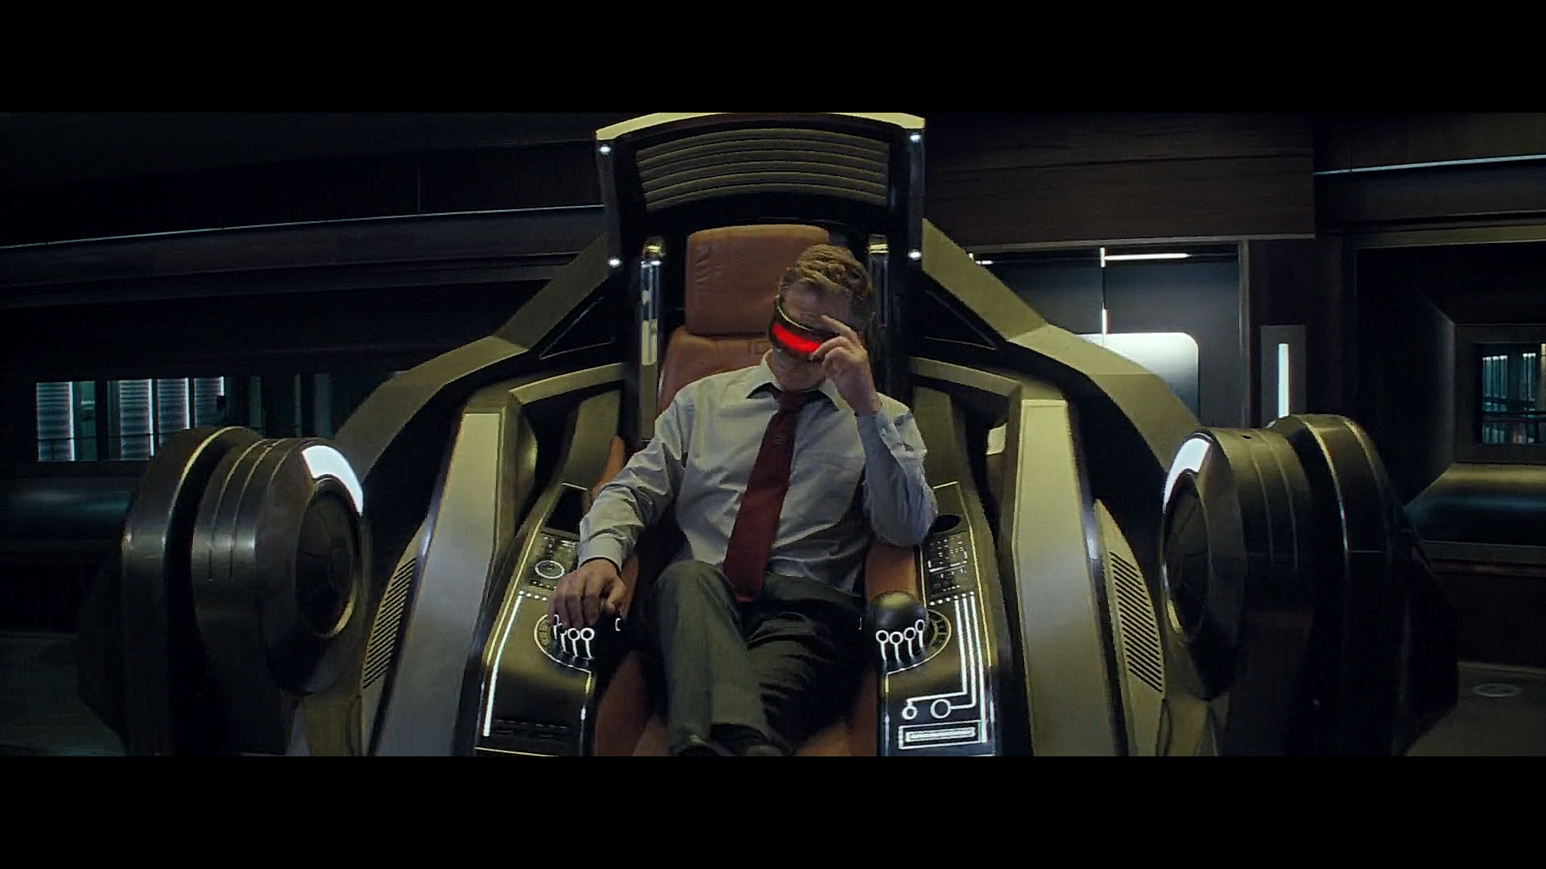
What is Wrong? – Round One
What is wrong with this image?
Notes:
For those who don’t know, this is a still from the movie Ready Player One, based of the novel of the same name. For those who have seen it, you should remember this scene, because it plays a curcial role in the success of the main character. Nolan, in the picture, has one fatal flaw in his office set up here. What is it?

Slide 5
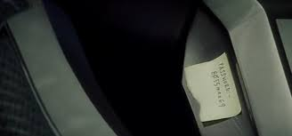
What is Wrong – Round One Results
These are stills from the movie Ready Player One, and this is the main antagonist, Nolan Sorrento’s office and computer interface.
If you look carefully, you can see a post it note, which contains his login password.
This is how the main protagonist, Wade Watts, is able to defeat him - because of bad information storage practices.
And what was his password?
The Password - B055man69
Notes:
That is exactly right, Nolan here has a Post-It note of his login information right in his workspace! Bad information storage and information security led his his own demise. Of course, his password ended up being, BO55man69

Slide 6
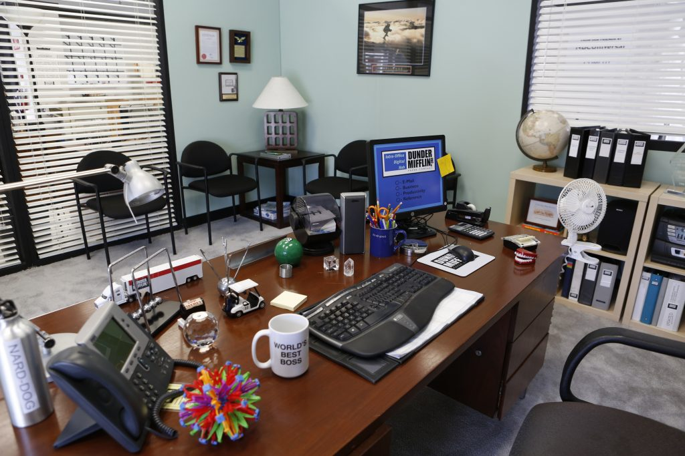
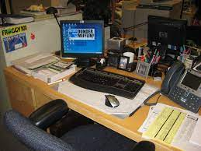
What is Wrong? – Round Two
What is wrong with one of these images?
Notes:
Okay round two, same objective as before, I am. Going to present you all with two images this time and I want you to find the big issue with one of them. Is everyone ready?

Slide 7
What is Wrong – Round Two Results
Just like the last round, there is one major mistake that the desk at the top made compared to the desk at the bottom.
Again, the desk at the top made the mistake of not keeping its password in a secure location, which is not secure in any way, compared to the desk at the bottom.
For those office fans in the audience: these are Michael’s and Dwight’s desks.
Notes:
That is exactly right, the same exact error as last time, Michael Scott (from The Office) left his password on his computer monitor out in the open! While this isn’t catastrophic, we can see a better example in the second image, of course being Dwight Schrutes desk.

Slide 8
Having seen some bad examples of information security, how could they have resolved their information security issues?
What steps could they have taken or tools could they have used to make their information more secure?
Notes:
Okay, so we now have a realistic expectation of what bad information security looks like but we now need to learn from those mishaps. So, what steps or tools could Nolan Sorrento or Michael Scott used to better their information handling practices?

Slide 9
The tool they should have used:
Password Encryption
Using password encryption, they could have avoided many of the problems that are involved with information security. By leaving their sensitive information out in the open, anyone could have come along and used their passwords for anything including credit card fraud, social media posts, malicious access to private emails.
Notes:
Exactly, they should have used a Password Manager.
Password managers are great tools, they are like an index for passwords and are used In both professional and private workspaces to make life easier but also more secure.
Using a password manager can help protect against things like credit card fraud, malicious access to social media or private emails and much more.

Slide 10
Introducing LOCKR
A Open-Source and Private Password Encryptor
Notes:
To help fight against bad information handiling practices, I would like to introduce LOCKR, a open-source, private, offline password manager.

Slide 11

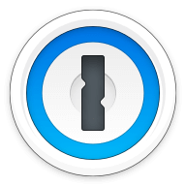

What is LOCKR?
LOCKR is a password encryptor, similar to many other products that have been in all manner of workplaces before, such as BitWarden, 1Password, and LastPass or a number of other services.
LOCKR stands for Logarithmic Offline Computer Key Resolver - defining not only the tool it needs but putting an emphasis on its modus operandi.
LOCKR is a offline, client-side only program that encrypts and stores passwords for easy, safe usage by anyone anywhere.
Notes:
So LOCKR is a password manager, much like others such as BitWarden, 1Password, or LastPass, but one of the maindifferences is that those products often have you send your information over the web to some server, hosted by someone else.
For many, they either have enough failed that nothing bad will happen to it or don’t realize this. This is exactly where LOCKR wants to step in.
LOCKR is inteneded to be wholistically offline, private, opensource, and self reliant.

Slide 12
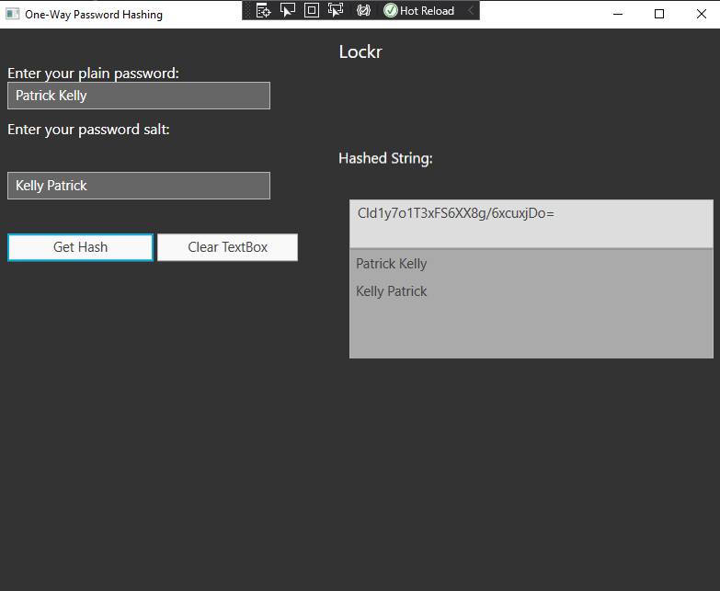
How is LOCKR different compared to other password encryptors?
The similarities end with the idea of a password encryptor, because our product was made by a small team of people with non-profit intentions. Our team wanted to make it a open source program so anyone can use, modify, and personalize the product as they see fit. This also allows for us to keep user data safe and secure by not sending it to a server but keeping it on a file on the computer.
However, we have included some features that are common with other password encryptors so allow users some ease-of-use benefits. They include:
-Choice to include special characters and capitalization
-Ability to choose the length of the password
-Showing the hash, password, and the salt

Slide 13
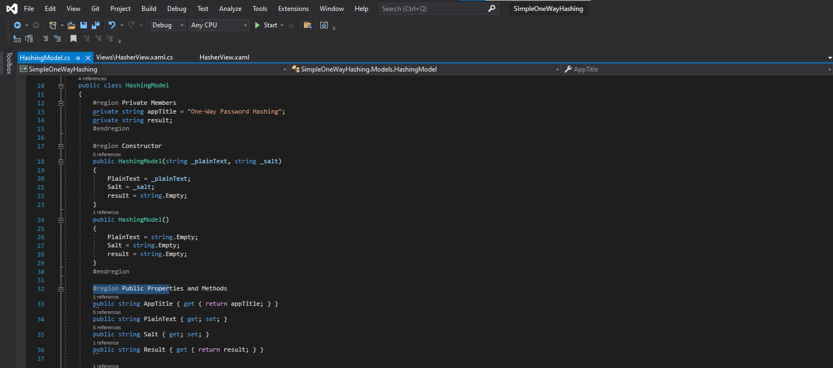
What are the benefits of using LOCKR over other products?
Like before, with other products working to. Transfer their information over the web, it can lead to a another level of vulnerabilities for people to be exposed to.
However, but utilizing a 100% client-side service like LOCKR, it takes out the possibility for things like MITM, DDOS, phishing, and vishing attacks. All these cyber-attacks are used everyday by both professionals and hackers everyday.
Tools like WireShark, MetaSploit, and other social engineering attacks can be done, even a beginner with limited technical experience can easily gain access to the program.

Slide 14
How does LOCKR work?
A password converter that turns a users password from their original password to a hash using SHA-1. This password is then saved on a list as well as the hashed password.
SHA-1 is a encryption standard made in 1995, but since 2017 has not been accepted anywhere on the web.
While SHA-1 is considered insecure, we used it in our program so we can demonstrate our proof-of-concept.

Slide 15
What is the User Experience?
User Password
The user inputs or creates the password
User Adds Salt
The user adds a value or string that is used to further encrypt the password
The Conversion is Completed
The salted hash, the salt, and original password is shown to the user once the hash is complete

Slide 16
Hashing - How does it work?
Input
Joe
Hash
Arbitrary length is added
Result
Ubeofva321$2Ba
Smith
(Hashed password)
A hashing algorithm is a mathematical algorithm that converts an input data array of a certain type and arbitrary length to an output bit string of a fixed length

Slide 17
What tools were used to create the program?
The program is manly coded in C#, Xaml, and .NET framework
Visual Studio for the IDE
SHA-1, meaning that 2^64 bits is used for the hash, creating a 160 bit hash

Slide 18
Future Development
While SHA-1 is insecure, had we developed it further, we would have utilized the industry standard SHA-256.
We also would have a more friendly User Interface.
Deployable off of a USB stick, for secure and transportable data security

Slide 19
Any Questions?
Please see the developers for any technical questions.

